Slide 1
Blockchain Introduction
what is the purpose of Blockchain

Slide 2
Agenda
01
02
03
04
Starter story
Data
integrity
Distributed
systems
Blockchain

Slide 3


MONEYMAN CO
Customer | Balance
Josh | 2’000
Alan | 60’500

Slide 4

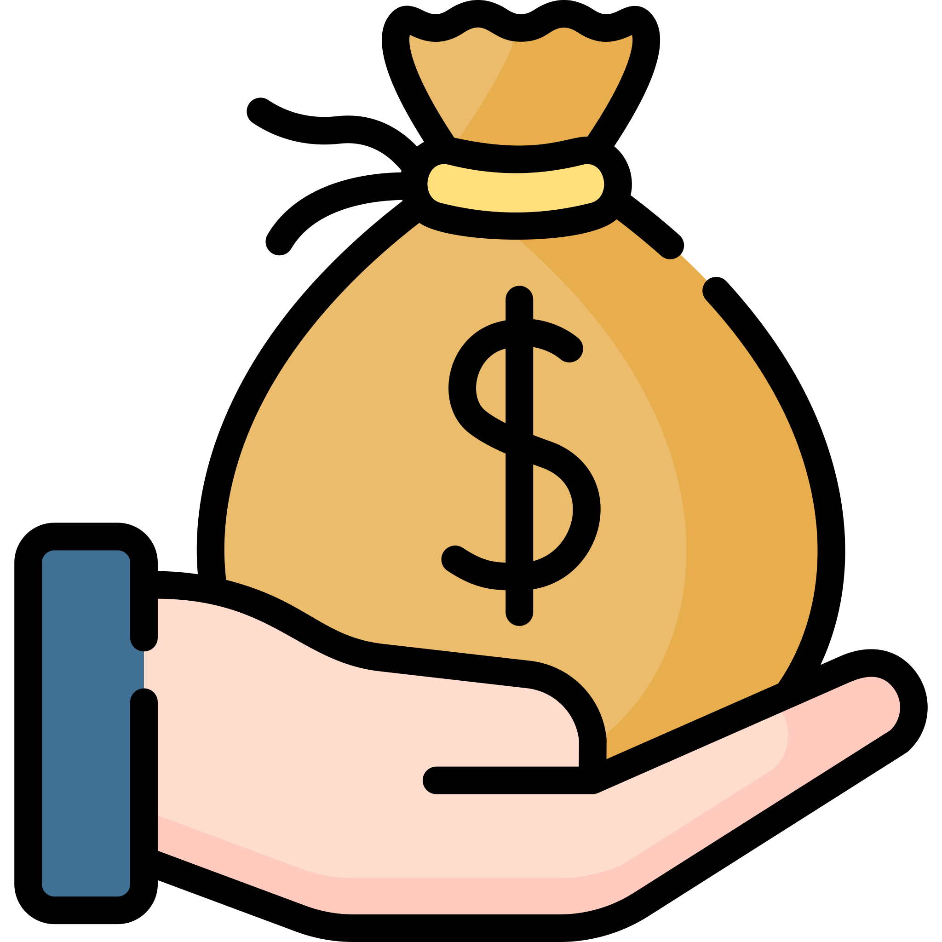

MONEYMAN CO
ALICE
Customer | Balance
Josh | 2’000
Alan | 60’500

Slide 5
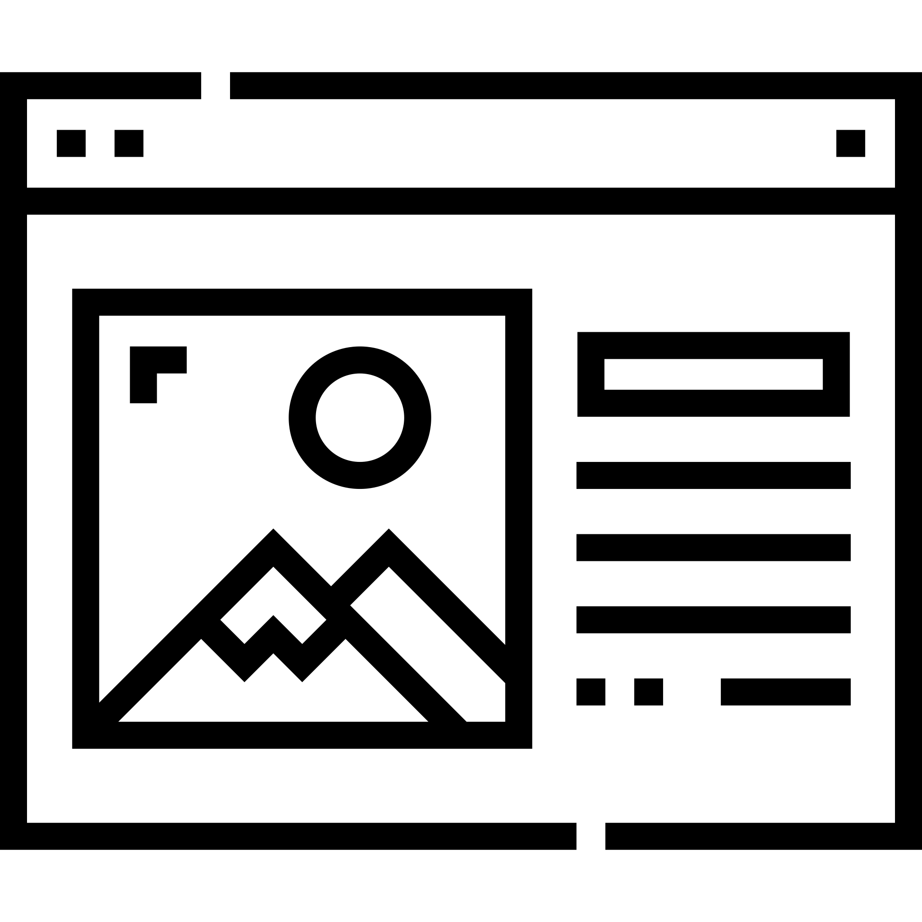
COMEFLYWITHME
ALICE
6 weeks vacaction
private transfer to island
5.5-star spa hotel
70,000 $

Slide 6
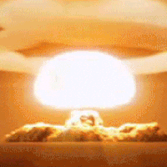
Customer | Balance
Alice | 1’000’000
Icon: Freepik
Notes:
kurzer Recap:
plötzlicher Feuer
zerstört Computer
Cliff-Hanger: Was jetzt? -> Lösung Backup einspielen

Slide 7
??
Customer | Balance
Alice | 25
!!

Slide 8
“We trust each other every day.
No matter if we pay with PayPal,
shop at Amazon or watching Netflix.”

Slide 9


How can we transfer data?
ALICE
Bob
Dave

Slide 10
We need to pay attention to…
Alice und Bob want to communicate with each other.
Dave shall not read nor manipulate any message.

Slide 11
Why it matters
If Dave can read the entire communication of Alice and the bank, he knows everything about Alice.
If Dave can manipulate the communnication, he could transfer all the money to himself

Slide 12
How can we achieve this
don’t read
Don’t manipulate
Encryption
Hashes
symmetric and asymmetric
We encrypt
our message,
so that only the sender and recipient can read
We add a checksum to the string and thus compare that a string has not been modified
fixed derived string that cannot be calculated backwards

Slide 13

The Clue
Only Alice and Bob can read the message,
no one can change it unnoticed
ALICE
Bob
Notes:
it doesn't matter if Dave is there
even better, we even share the message with Dave,
when Alice and Bob disagree, Dave has the solution without knowing what the solution is.

Slide 14


Back to our story
Does Alice have one million dollar on her bank account?
ALICE
Notes:
it doesn't matter if Dave is there
even better, we even share the message with Dave,
when Alice and Bob disagree, Dave has the solution without knowing what the solution is.
we can share the message with anyone we like

Slide 15

That’s genius, isn’t it?

Slide 16

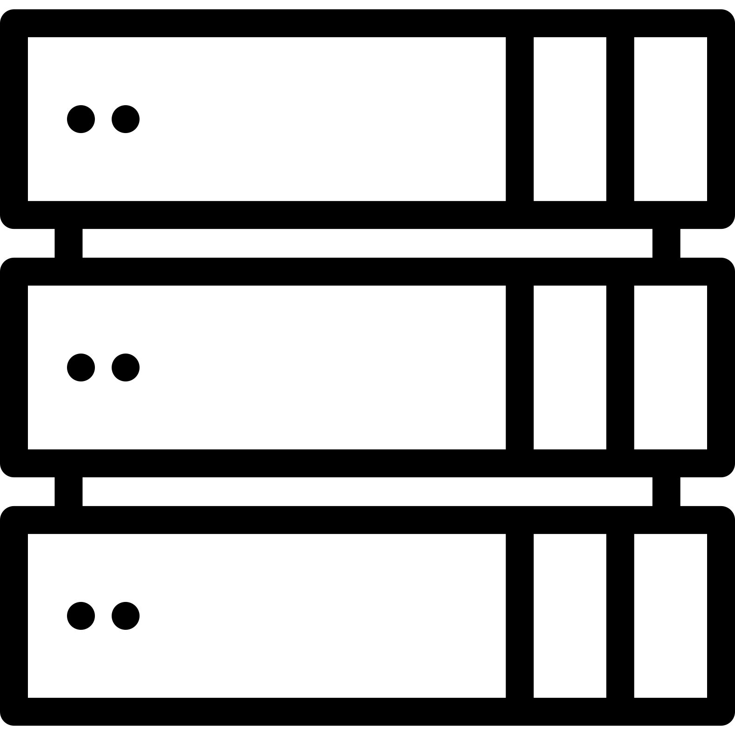
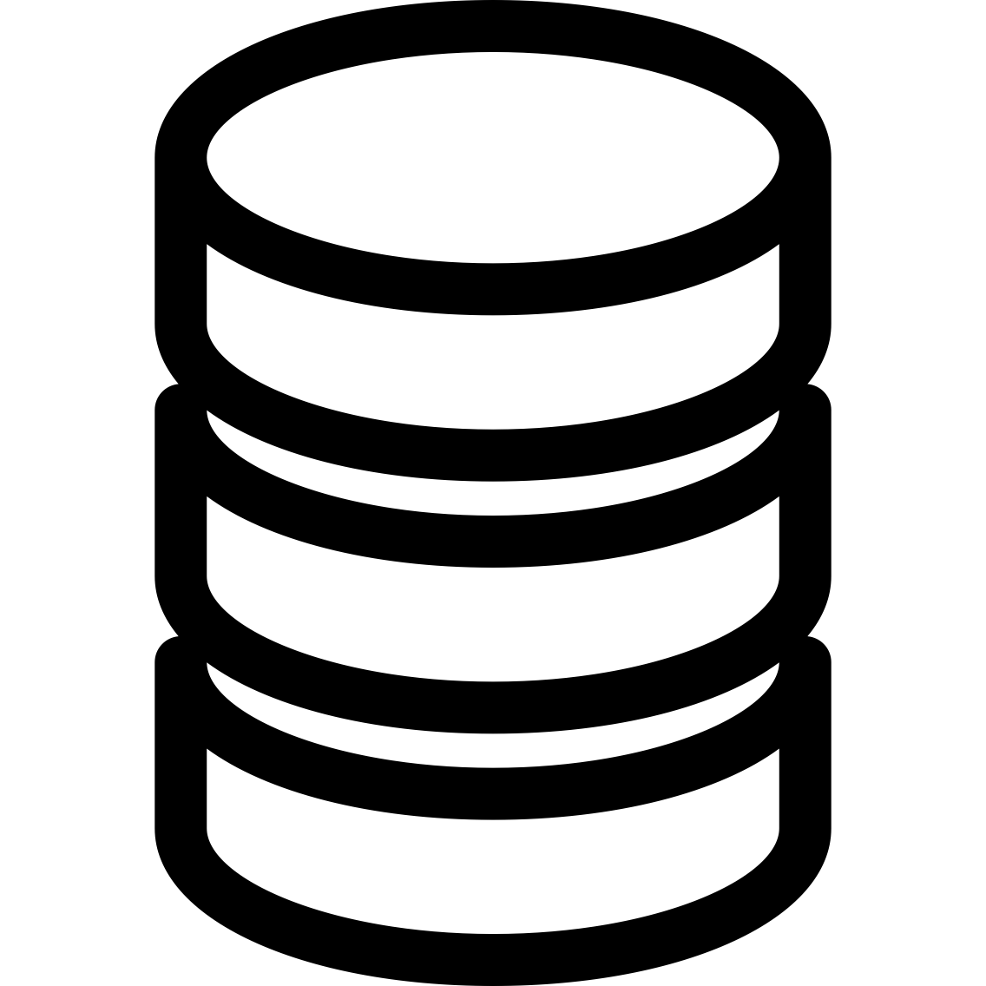
Client-Server Architecture

Slide 17
Peer-To-Peer Network

Slide 18
P2p vs Client-Server
Trust
Speed
Transparency
Redudandcy
We don’t need to trust a single party
Everyone needs to be informed about changes
Everyone can see what’s happening
Everyone owns an entire data copy

Slide 19
"A distributed system gives each participant equal rights. It is client and server at the same time".

Slide 20
Blockchain
At the end of the day, Blockchain is simply a database
Instead running on one node, it runs on every computer in a distributed system

Slide 21
PROBLEM
SOLUTION
In a distributed system, every participant has all the data.
But who decides which data to add?
We must achieve conensus to decide, which data we add

Slide 22
Classic DB
Blockchain
Data is stored in tables
We don’t save transactions, we save the result of a transaction
Every entry has a primary key, to be uniquely identified
Data is stored in blocks
We save transactions
There are no single entries, only transactions uniquely identifiable via a hash
Notes:
we get the account balance by aggregating all single transactions

Slide 23
Classic DB
Blockchain
0 EurO
0 EurO
previously in DB
+ 10 EurO
+ 40 Euro
- 20 Euro
+ 10 EurO
+ 40 Euro
- 20 Euro
we store this information in the Blockchain
30 EurO
30 EurO
now in the DB

Slide 24
Classic DB
Blockchain
358f6495a: Alice → Dave: 10
Customer | Balance
Dave | 30
f82ed7ea6: Tom → Dave: 40
3304a58ce: Dave → Ben: 20
Notes:
Blockchain, wir rechnen den Kontostand aus, in dem wir über alle Transaktionen gehen

Slide 25
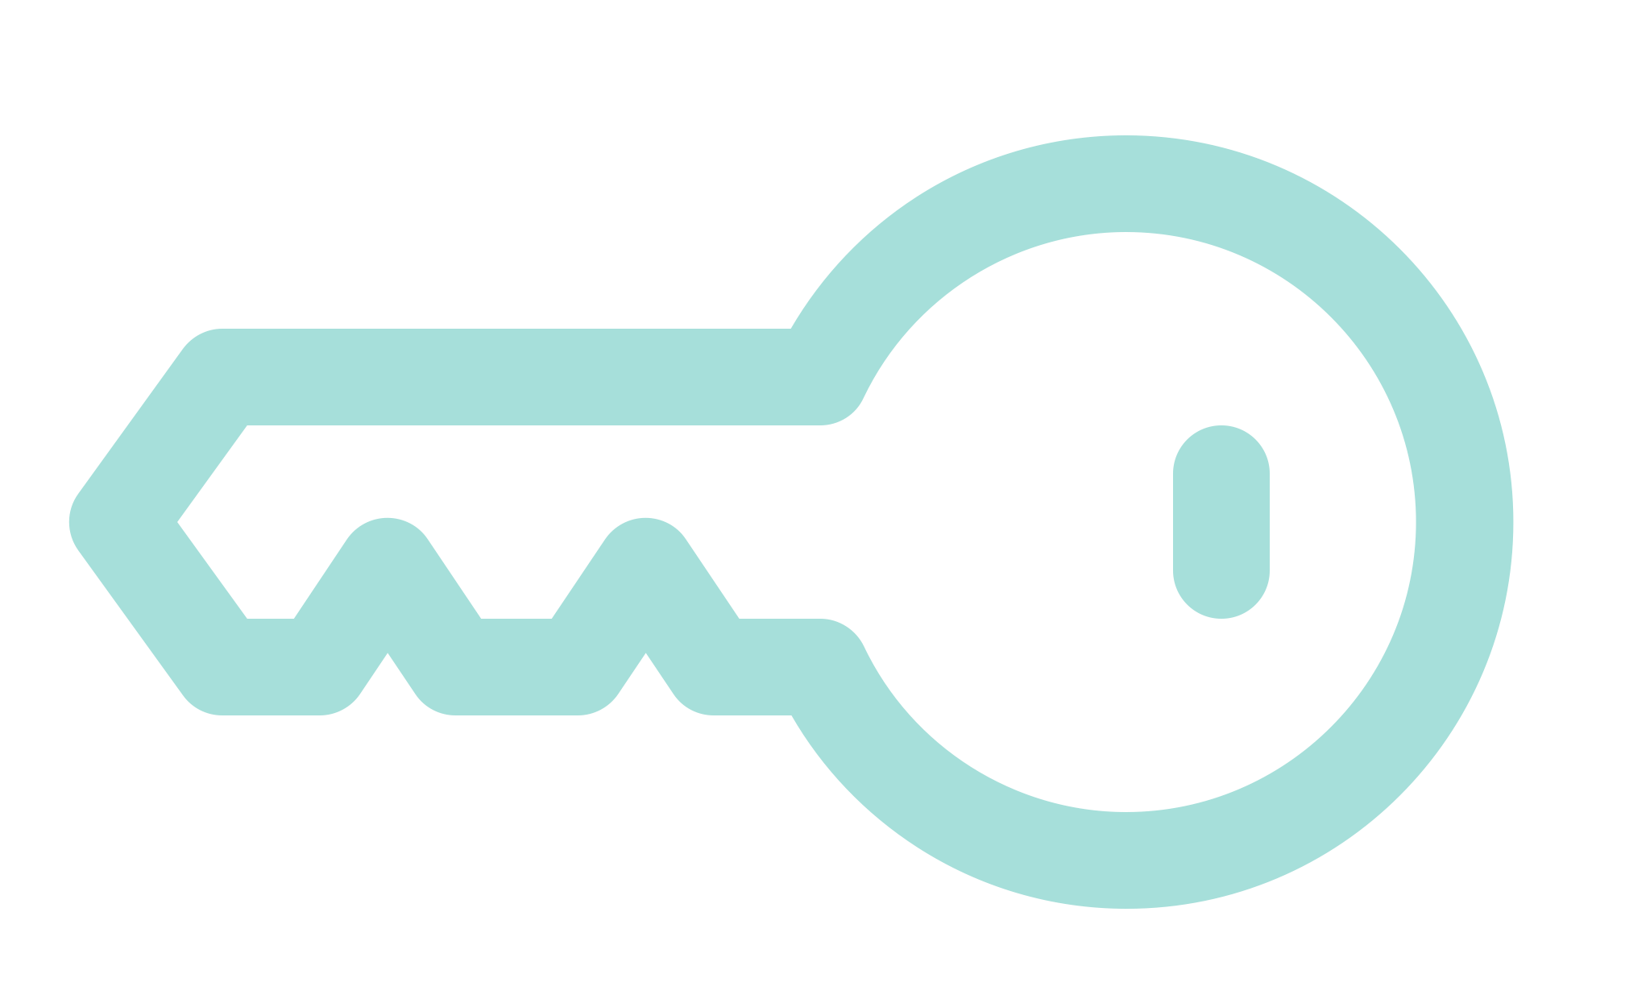
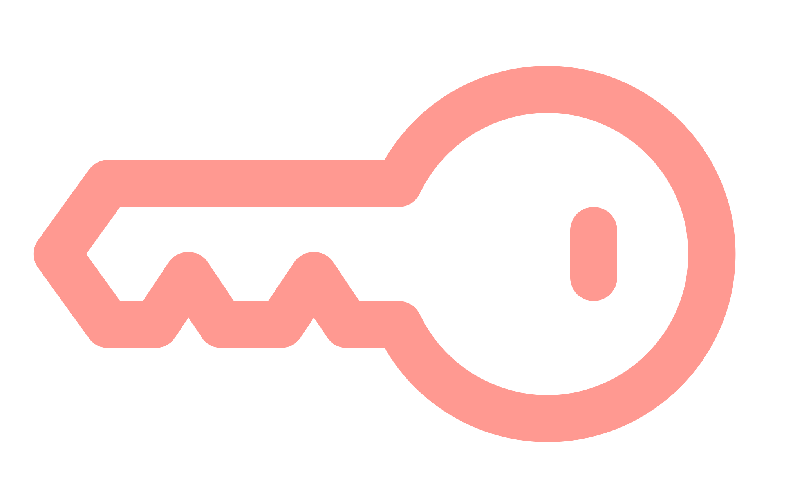
Transaction
Alice sends 10 Coins to Dave
private key
Alice → Dave: 10
Transaction from 03/14 11:05:34
public key
Hash: 72931ff005568
Hash: 2e1bc58c0084f
Notes:
who to whom how much and timestamp: that's all you need to know about the transaction.
Hash: -> means to ensure that transaction data has not been altered
Asymmetric encryption
Sign hash

Slide 26
What are blocks?
?
What would be the problem if we only sent these transactions on a public network?
Notes:
Spam!

Slide 27
"How can we distinguish,
whether a transaction is spam or not?
- We make them cost something."
Notes:
=> Konsensfindung

Slide 28
So far…
01
02
03
04
Blockchains are distributed systems
We store transactions
We need a spam protection
Each transaction costs something

Slide 29
Who gets the money?
?
?
To whom should the transaction fee go?
We introduce power users (miners) with the task of checking transactions for validity and sharing non-spam transactions with the network.
For this they get the transaction fee

Slide 30
360,000
36
10,000
would result in 360k decisions
we bundle 36 transactions to one single decision
much less data transfer
Notes:
100 transactions per second
360k transaction per hour -> insanely slow
36 decisions bundled
10k decisions per hour
Block processing

Slide 31
Block
We need a spam protection against miner!
Block #45
Block from 03/14 11:06
Hash: 72931ff005568
Alice → Dave: 10
Hash: 2e1bc58c0084f
Transaction from 03/14 11:05:34
Bob → Dave: 20
Hash: f16f05d3e1ffe
Transaction from 03/14 11:05:35
Dave → Josh: 3
Hash: f19ef7817b158
Transaction from 03/14 11:05:36
Notes:
3 transactions merged into one block
Timestamp
hash over all hashes that no one has sneaked a transaction into the block yet
Miners do not pay with money but in, which they solve a complicated task

Slide 32
Block
Block #45
Block from 03/14 11:06
Hash: 72931ff005568
Previous block hash: 00041a247b521
Find a string, so the blockhash begins with 0s
Notes:
Nonce
The effort is immense
previous block as reference -> old blocks cannot be changed
short break, let it sink in

Slide 33
So far…
Notes:
Blockchain different from DB: distributed and transparent.
-> as a consequence: everyone is equal in the network and we store the whole history of the data
-> again as a result: mechnaism to check transactions and spam protection
-> result: new role (miner)
-> transactions grouped in blocks with reference to the previous block
-> Cryptographic challenge
Insanely difficult to solve -> energy consumption Netherlands, electronic waste
Transition to advantages and disadvantages

Slide 34
Advantages
Transparency
Robust
Tamper
History
Costs
Trust
Everyone can see and verify data
More participants means more stability
Tamper-proof since old data cannot be changed
Entire history of data is captured
More miners battle with cheaper costs
We don’t need to trust a single party anymore

Slide 35
Disadvantages
Redundancy
Size
Speed
Privacy
Costs
Consensus
A lot of copies of the same data are stored somewhere
Every operation adds more data
Such a network is very slow
Append-only means no deletion. One time added, always there
Every participant needs to pay to add data
Proof-of-Work uses an enormous amount of computing power

Slide 36
Bitcoin and Ethereum
Blockchain for crypto currencies
money history transactions are stored
everyone is pseudonymous
no dependencies on banks
limited amount (controlled inflation)
easy to trade internationally, does not get lost
but no anonymity

Slide 37
Potential Use Cases
Government
Insurances
Electricity
Supply chains
State information, e.g. land register
Claims can be stored on blockchain
Renewable energies and compensations
Contracts are concluded with suppliers via blockchain

Slide 38
Questions? Remarks?

Slide 39
Thank you!
Please keep this slide for attribution.

